Slide 1

Savitribai Phule Pune University Savitribai Phule Pune University
Fourth Year of Computer Engineering (2015 Course)
Project Presentation On
“Cloud Based DevOps Skill Assessment Application”
Group ID : 10
Name of Students :
1. Chetan Pawar
2. Roshan Patil
3. Nishant Kumar
4. Yogesh Mahajan
Name of Guide :
Prof. Amar More

Slide 2
Presentation Outline
Introduction and Motivation
Problem Statement
Literature Survey
Challenges Identified
Methodology
Technologies/Platform Used
Conclusion
References

Slide 3
Introduction and Motivation
Now a day’s many online tools are available to test the programming knowledge of the person like codechef.
But in order to test the knowledge of the DevOps there is no such online tool available.
So the aim is to develop the cloud based infrastructure to test the knowledge of DevOps of the examinee.
This project aims to establish a reasonable, objective, quantized evaluation standard of analyzing examination and score, and develop the evaluation index system of examination questions and examination result analyzing.

Slide 4
Problem Statement
To develop a backend infrastructure and web based application to assess DevOps and Linux administration skills.

Slide 5
Literature Survey

Slide 6
Challenges Identified
Infrastructure challenges | Web/Frontend challenges
Container Scheduling , Management and Monitoring Security Load Balancing Cost Effective System | Terminal environment on client browser Communication with backend server

Slide 7
Methodology
Need of live environment for a real time assessment of practical knowledge.
For this we need to provide a real system to the users. This can be highly inefficient and costly.
On the other hand , we can use virtual system which can be a better approach but not reliable.
Issues with Virtual Machine:
Network connections
Wastes valuable computing resources
These issues can be solved by Containers.

Slide 8
Containers
A container consists of an entire runtime environment: an application, plus all its dependencies, libraries and other binaries, and configuration files needed to run it, bundled into one package.
By containerizing the application platform and its dependencies, differences in OS distributions and underlying infrastructure are abstracted away.
Docker is the leading container platform and mainly used.
Notes:
Advantage of containers over virtualization :
With virtualization technology, the package that can be passed around is a virtual machine, and it includes an entire operating system as well as the application. A physical server running three virtual machines would have a hypervisor and three separate operating systems running on top of it.

Slide 9
Docker
With Docker, you can manage your infrastructure in the same ways you manage your applications. By taking advantage of Docker’s methodologies for shipping, testing, and deploying code quickly, you can significantly reduce the delay between writing code and running it in production.
Docker provides the ability to package and run an application in a loosely isolated environment called a container. The isolation and security allow you to run many containers simultaneously on a given host.

Slide 10
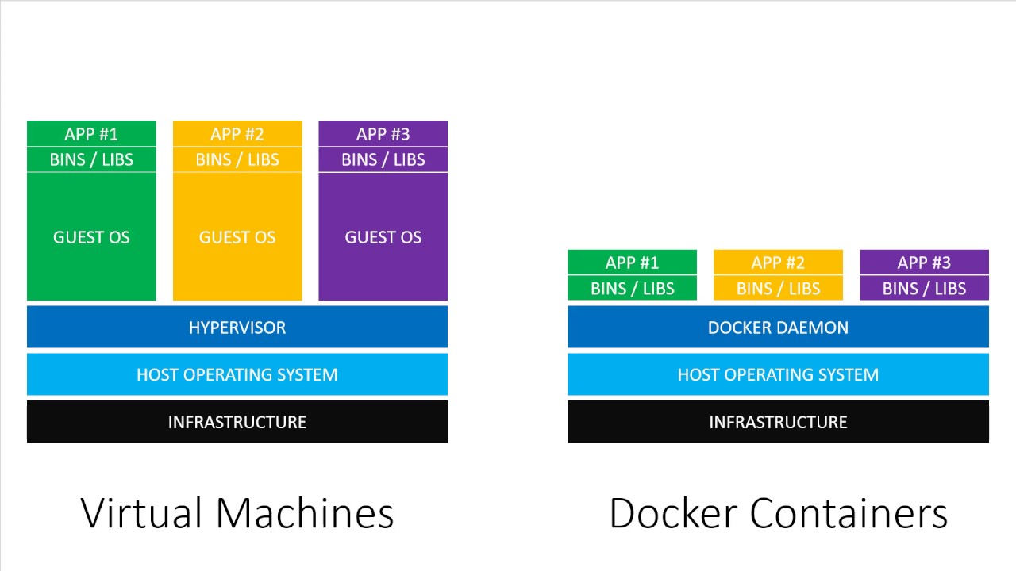
VM vs Container

Slide 11
Is Docker sufficient?
Now we have a great container solution, capable of handling large amounts of traffic, but it is based on a lie.
Well, a lie might be a little unfair, so let's say it is based on an abstraction.
The containers are still running on a machine with finite resources, so we want that work to be split among multiple machines.
What if one of those machines goes down and you need to move containers?

Slide 12
Container Orchestration
Container orchestration is all about managing the lifecycles of containers, especially in large, dynamic.
It is some sort of system to manage all of the bare metal machines or virtual machines that you need to run your containers on. This system could manage your containers, launching them on the underlying machines, making sure they are distributed, and keeping them healthy.
Kubernetes is one such system.

Slide 13
Kubernetes
Kubernetes offers a wide range of advantages: first, it poses high scalability, easier container management and helps to reduce the delay in communication, another issue which maybe be connected with Docker.
Pods, or groups of containers can group together container images developed by different teams into a single deployable unit.
Kubernetes services provide load balancing, naming and discovery to isolate one microservice from another.
Namespaces provide isolation and access control so that each microservice can control the degree to which other services interact with it.
Load Balancing

Slide 14
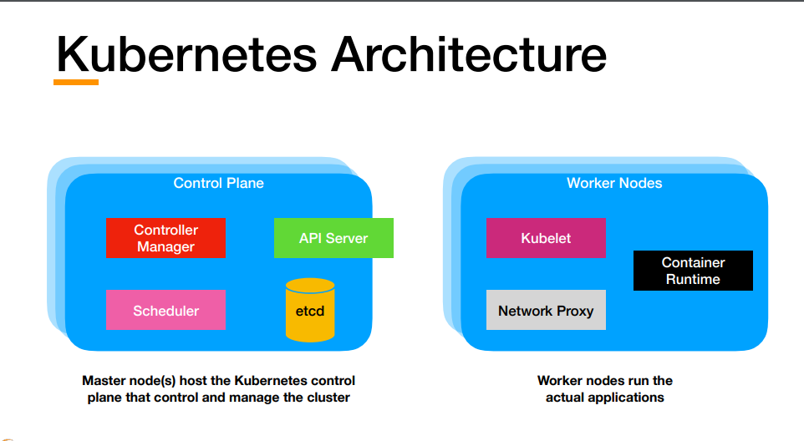

Slide 15
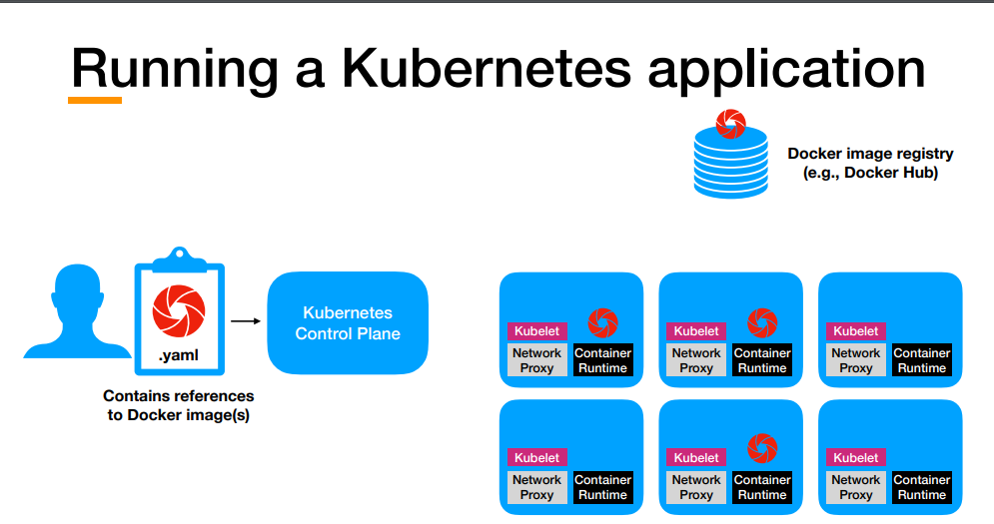

Slide 16
Load Balancer
A load balancer is a device that distributes network or application traffic across a cluster of servers. Load balancing improves responsiveness and increases availability of applications.
A load balancer sits between the client and the server farm accepting incoming network and application traffic and distributing the traffic across multiple backend servers using various methods.

Slide 17

Load Balancing
SERVER
Node 1
Node 4
Deployments
D 1
Node 2
Node 3
D 2
LB
D 3
Load Balancer
D 4

Slide 18
Architectural View
Company
Candidate
Infrastructure

Slide 19
Company
Request for exam
Creation of Test Structure
Test environment
Result
Candidate

Slide 20
Infrastructure
Container Creation
Container Deployment
Building Cluster
CLUSTER
Monitoring
Load Balancer

Slide 21
Hardware Used
Server (Master) | Client (Slave)
8 GB RAM Intel core i5 processor and above Cores 8 or more CPU 2.4 GHz or greater 80 GB HDD | 2 GB RAM Intel core i3 processor and above Core 1 or more CPU 2.4 GHz or greater 120 GB HDD

Slide 22
Technologies Used
Linux
Docker
Kubernetes
Python-Django Framework

